Slide 1
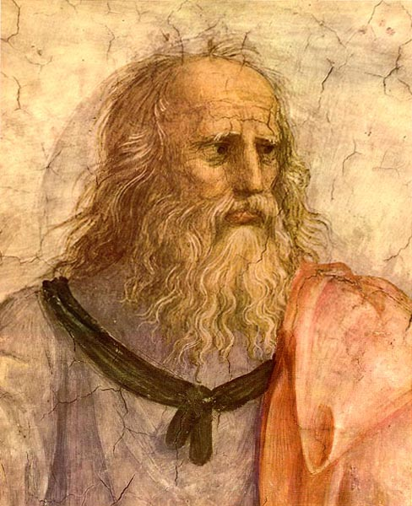
Plato
428-347 B. C.

Slide 2
The life of Plato
Born in Athens in 428 B. C.
Born into a wealthy family
Considered a career in politics but rejected it
Annoyed by Athenian society, especially the treatment and execution of Socrates
Became Socrates’ pupil when he was about 20
Devoted follower and friend of Socrates
He left Athens after Socrates’ death, for his own safety

Slide 3
The life of Plato
He travelled around Asia Minor, Egypt, Southern Italy and Greece
Returned to Athens in 388 B.C.E.
Founded “The Academy” – this was the first European university
It lasted until 529 A. D.
Died in 347 B. C.
Plato is buried in the grounds of the Academy

Slide 4
Plato’s beliefs
True knowledge could only be found through the intellect and by reason
The senses could not be trusted and should be ignored
In the material world things grow, change, decay
For something to really exist it must have some “unchangeability” to it.
For example - The body changes, therefore it doesn’t truly exist, unlike the soul, which is spiritual and does not change – therefore it exists

Slide 5
Plato’s concerns
Ethics – how people should live
- Like his mentor and friend, Socrates, Plato believed that humanity should be on a quest for good, truth and beauty
Humanity should be on a journey “upward” - from the material to the spiritual
He went further than Socrates - Plato tried to understand reality and how we perceive it
He asked questions like “What is roundness?”, “What is blackness?” and “What is ‘treeness’?”
Plato became concerned with the question of meaning and understanding – i.e. Metaphysics

Slide 6
Plato’s ‘Theory of Forms’ (Ideas)
Concern for meaning + distrust of the senses = THEORY OF FORMS (IDEAS)
He believed humans were exposed to two worlds at once
The world of the senses – a world of appearances and change
The world of the truly authentic – this is the world of unchanging ideas
He wrote about his theories in a book called ‘The Republic’
The story of the Cave is about the two worlds

Slide 8
The Allegory of the Cave
World of ideas = real world
World we perceive through senses = illusion
It is an imperfect shadow of the more perfect world
We come to understand it by using our mind
Imagine the philosopher is the escaped prisoner
Feels he must teach the other prisoners about reality and help them understand
He must teach others of their illusions so they may see what is false and what is true
TRUE REALITY IS THE REALM OF IDEAS

Slide 9
Plato’s belief
We are living and experiencing two worlds at once
The realm of the senses (what we see around us)
The realm of ideas (what we can understand in our mind)
The senses cannot be trusted
It’s merely appearance
Physical
ever changing

Slide 10
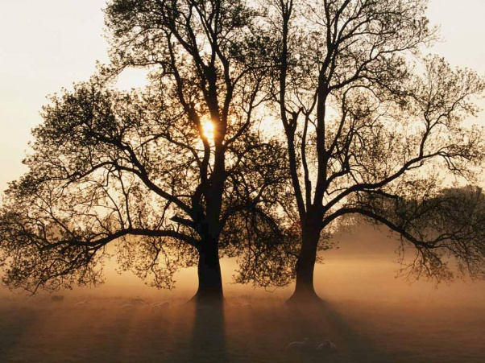
Example - The Tree
The tree in the Realm of ideas
Tree as it is seen
through the senses
leaves
leaves
leaves
Branches
Branches
Branches
Branches
leaves
leaves
Bark
Roots

Slide 11
What does Plato mean by this?
There are many trees that we can see but they are only shadows or copies of the perfect idea of a tree that exists in another realm
A basic idea in the “realm of ideas” remains unchanging.
However, when it is projected into this realm it changes/alters slightly
This is how we get many types of the same thing – different kinds of trees, chairs, tables, flowers, insects etc

Slide 12
Plato’s bigger issue
Plato believed that the human person was deeply divided
The body and the soul were in conflict
The body is constantly changing – not real
The soul remains the same – real
Plato believed that the body imprisoned the soul – known as the dualistic understanding of the human being

Slide 13
Example from ‘Sophie’s World’
In the novel, ‘Sophie’s World’, the little girl gets to meet Plato and he asks her to think about four questions:
How can a baker bake 50 identical biscuits?
Why are all horses the same?
Do humans have an immortal soul?
Are men and women equally sensible?

